Slide 1
Survey of Data Science
By Yaohang Li, Ph.D. Department of Computer Science Old Dominion University yaohang@cs.odu.edu

Slide 2
Agenda
The Growth of Data and Definition of Big Data
Handling Data with Large Volume
Handling Data of Different Types
Audio
Graph
Sensor
Text
Point Cloud
Handling Streaming Data
Pitfalls of AI and Data Analysis

Slide 3
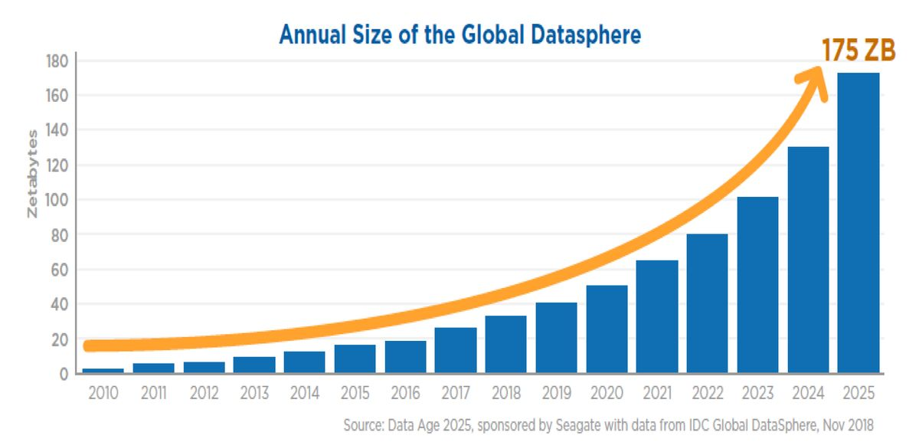
The growth of data

Slide 4
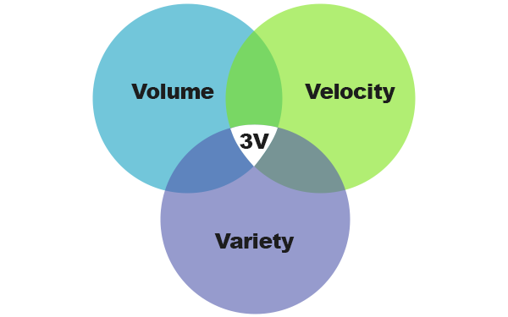
3V Definition of Big Data
Volume
The amount of data
Terabytes+
Records, transactions, tables, files
Velocity
The speed of data generation
Batch
Real Time
Streaming
Variety
Data types
Structured
Unstructured
Semi-structured

Slide 5
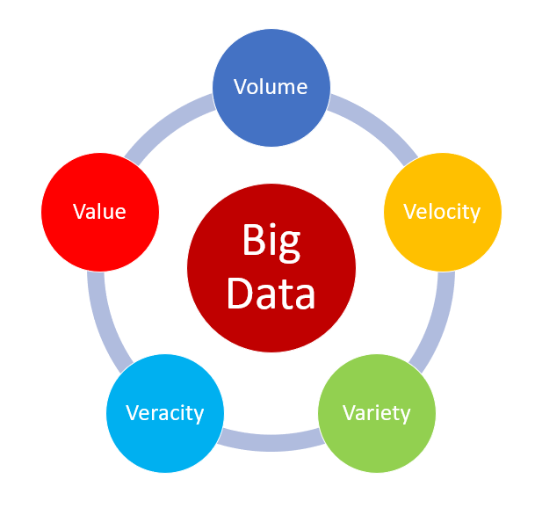
5V Definition of Big Data
Volume
Velocity
Variety
Veracity
Inconsistencies
Uncertainty
Incomplete
Quality and Accuracy are difficult to control
Value
Extract valuable information

Slide 6
The Critical Issues of Data Analysis
Handling Large Volume of Data
Handling Different Data Types
Handling High Speed of Streaming Data
Handling High-dimensional Data
Handling Uncertain Data
Handling Incomplete Data
Handling data with low value density and meaning diversity

Slide 7
Agenda
The Growth of Data and Definition of Big Data
Handling Data with Large Volume
Handling Data of Different Types
Audio
Graph
Sensor
Text
Point Cloud
Handling Streaming Data
Pitfalls of AI and Data Analysis

Slide 8
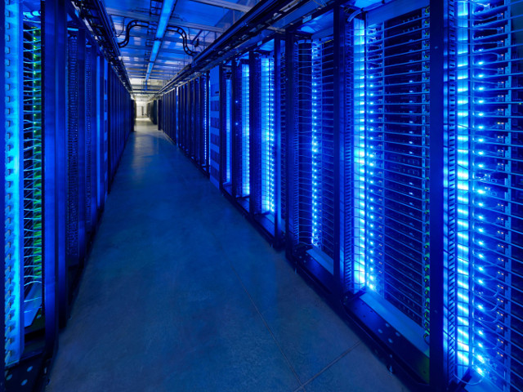
Techniques for High Volume of Data
Massive Parallelism
Huge Data Volume Storage
High-Speed Interconnection Networks
High-Performance Computing
Large-scale Task and Thread Management
Data Distribution and Retrieval
Machine Learning/Data Mining Algorithms
Data Visualization Techniques
Large-scale Database Management

Slide 9





Big Data Platforms
Apache Hadoop
A framework for the distributed processing of large data sets across clusters of computers using simple programming models.
Apache Spark
A unified engine for big data processing
Mesos
Resource management and scheduling across datacenter
Cassandra
Database management system designed to handle large amounts of data across many commodity servers
Kubernetes
Automating deployment, scaling, and management of containerized applications

Slide 10
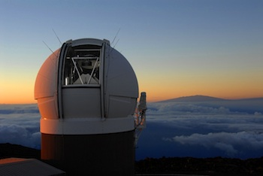
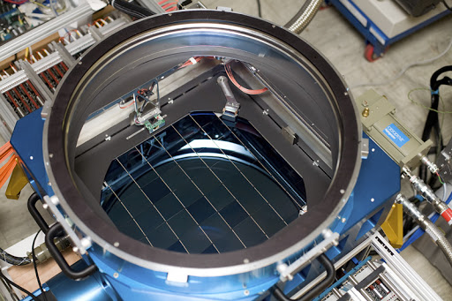
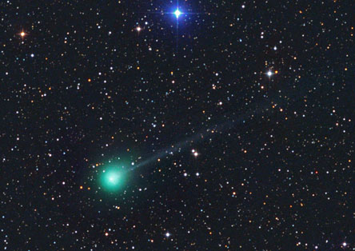
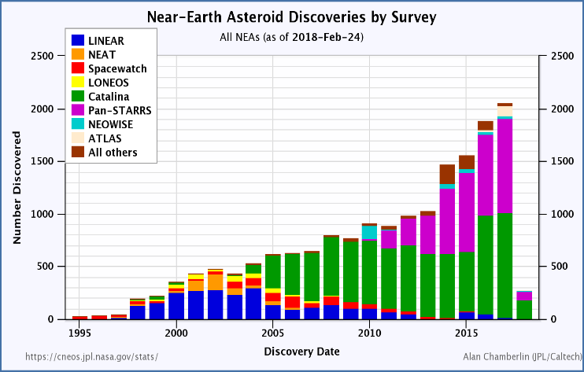
Large-Scale Sky Monitoring
World’s largest digital camera with almost 14,000,000,000 pixels.
Pan-STARRS has the world’s largest digital cameras to detect the threat to the earth from asteroids and comets.
Source: Pan-STARRS project

Slide 11
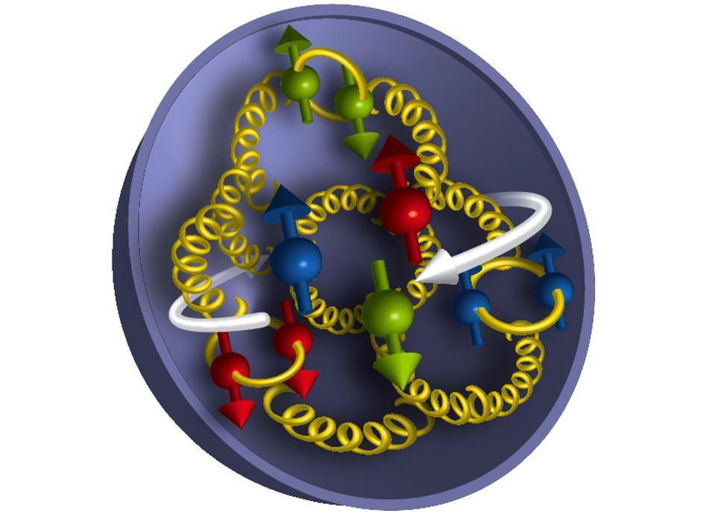
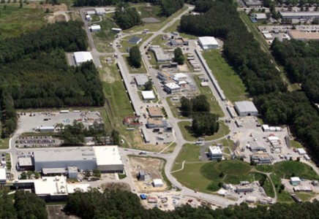
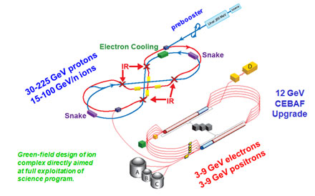
Physical Event Analysis
Femtography Problem: What does a neutron look like inside?
Thomas Jefferson National Accelerator Facility produces more than a petabyte (one million gigabytes) of data every year it runs, and that number is expected to double or triple in the near future.

Slide 12
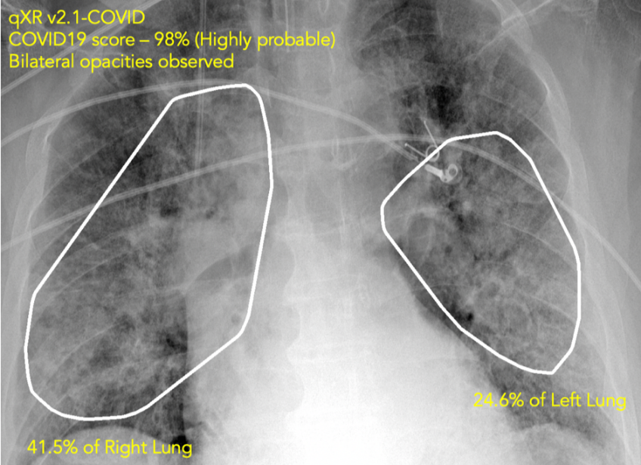
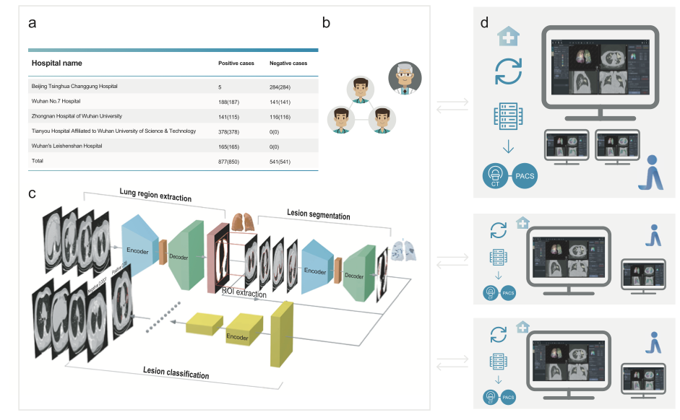
COVID19 Diagnosis
AI runs smack up against a big data problem with tens of thousands of patients’ CT scans to develop COVID-19 diagnosis in four weeks
Source: https://www.zdnet.com/article/
ai-runs-smack-up-against-a-big-data-problem-in-covid-19-diagnosis/

Slide 13
Agenda
The Growth of Data and Definition of Big Data
Handling Data with Large Volume
Handling Data of Different Types
Audio
Graph
Sensor
Text
Point Cloud
Handling Streaming Data
Pitfalls of AI and Data Analysis

Slide 14
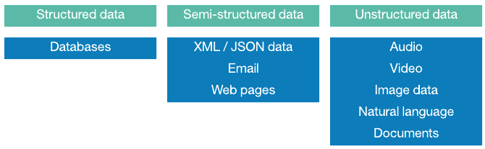
Data Types
Structured Data
Organized data
Fit neatly into row and column structure of the relational database
With defined length and format
Semi-Structured Data
Semi-organized
Unstructured Data
Unorganized
Cannot fit into row and column structure

Slide 15
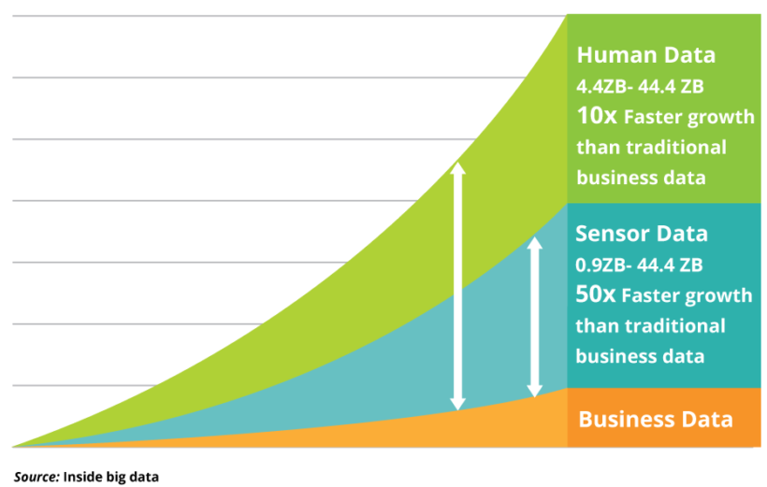
The growth of different kinds of data
Unstructured Data
Structured Data

Slide 16
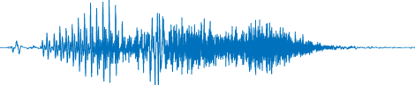
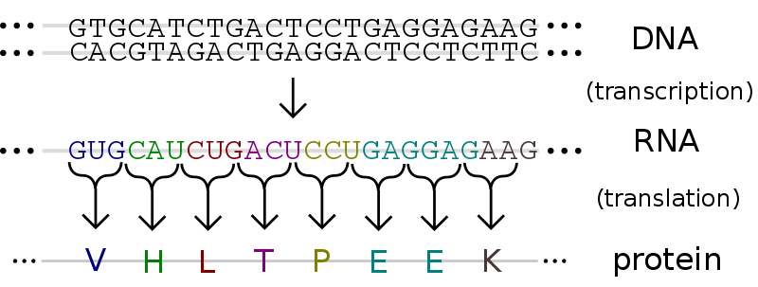
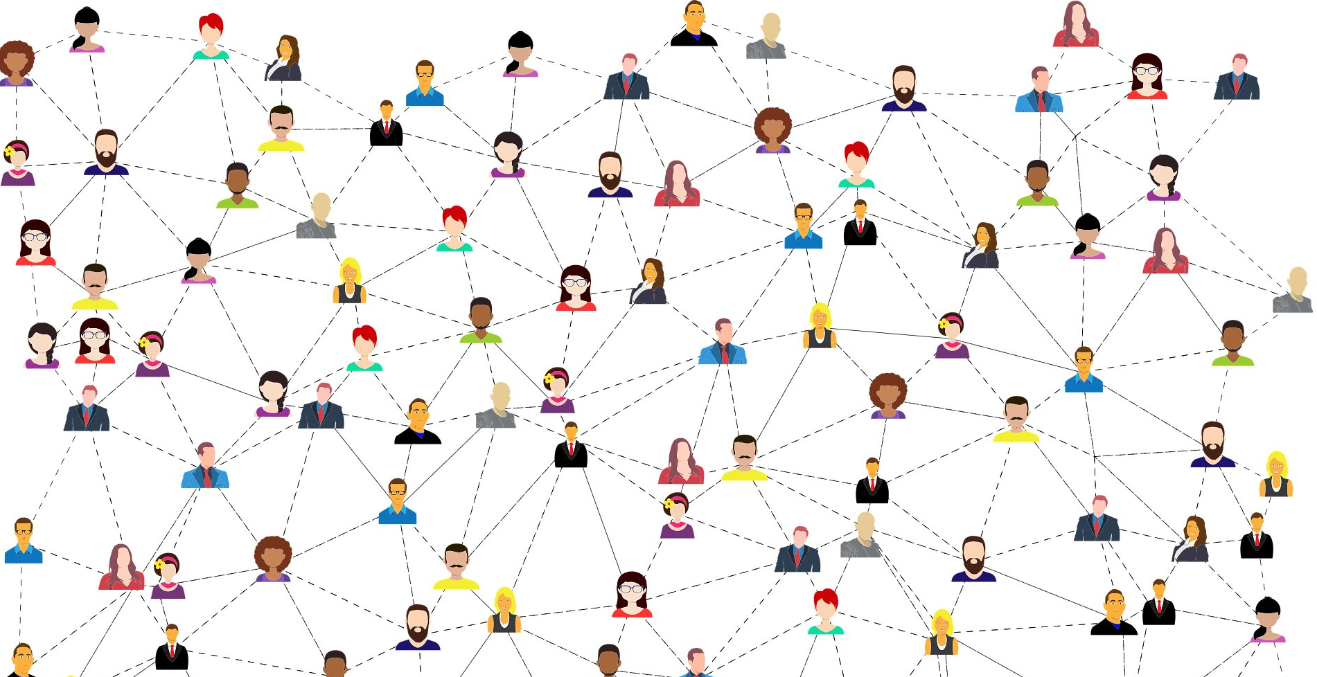
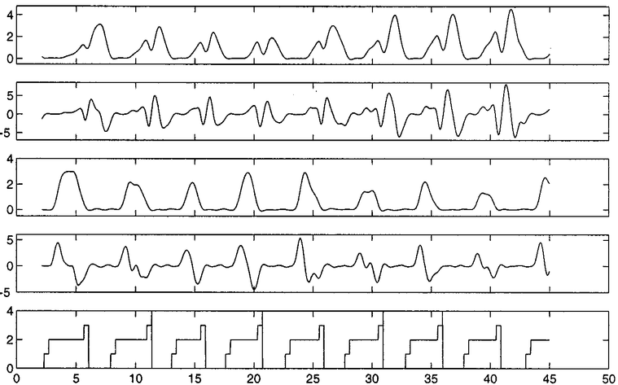
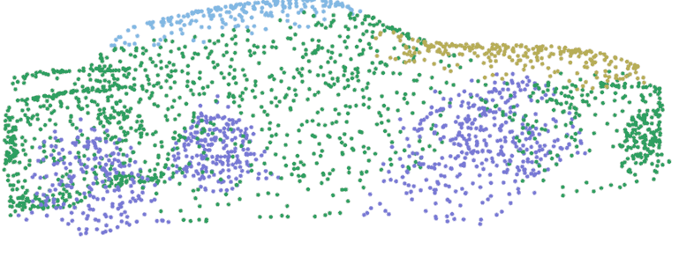
Handling different types of data
Audio
Graph/Network
Sensor Signals
Texts/Sequences
Point Cloud

Slide 17
Agenda
The Growth of Data and Definition of Big Data
Handling Data with Large Volume
Handling Data of Different Types
Audio
Graph
Sensor
Text
Point Cloud
Handling Streaming Data
Pitfalls of AI and Data Analysis

Slide 18
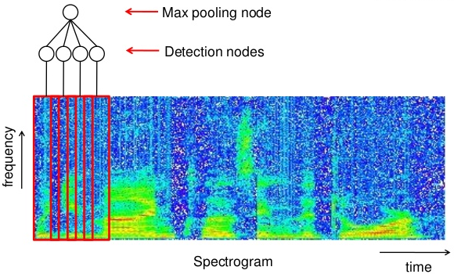
Speech Recognition
In 2017, Google announced that their speech recognition had a 95% accuracy rate. 22% search queries in Google are made by voice in 2019 and will climb to 50% in 2020.

Slide 19
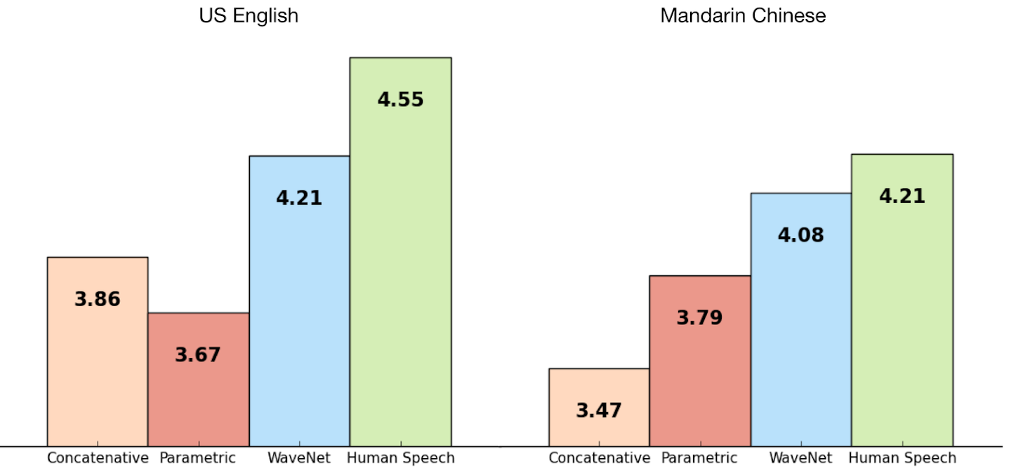
Sound Generation
DeepMind’s WaveNet is able to generate speech which mimics any human voice. It sounds more naturally than the best existing Text-to-Speech systems and is very close to human speech measured by opinion scores.

Slide 20

Sound Generation (Cont.)
WaveNet speaks with different voices.
WaveNet makes music.
Source: WaveNet

Slide 21
Agenda
The Growth of Data and Definition of Big Data
Handling Data with Large Volume
Handling Data of Different Types
Audio
Graph
Sensor
Text
Point Cloud
Handling Streaming Data
Pitfalls of AI and Data Analysis

Slide 22
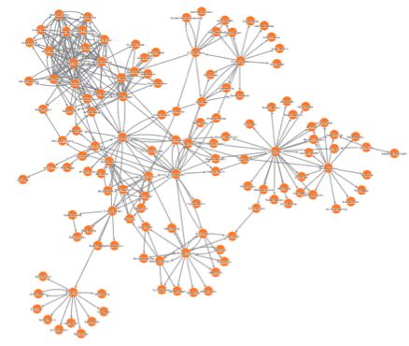
Analysis of Graph Data
Node Classification
Classifying nodes in Graph
Node Attribute Prediction
Inferring missing attribute values of some nodes
Link Prediction
Inferring missing relationships between entities
Finding hidden connections
Community Detection
Inferring communities or clusters of nodes
Graph Classification
Discriminating between graphs of different classes
Pattern Identification
Mining specific patterns in a graph

Slide 23
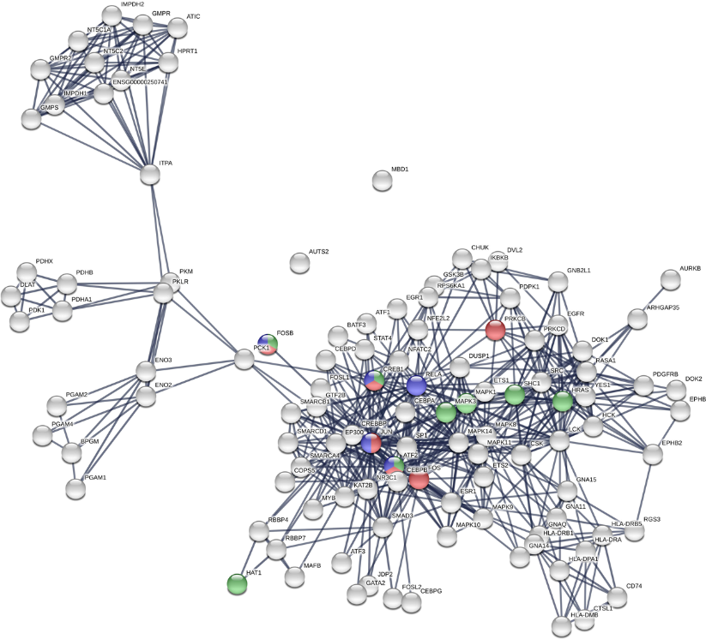
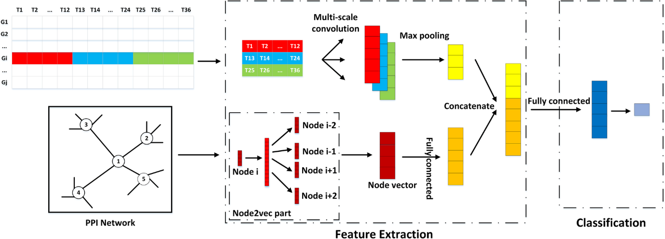
Node Classifications
Identifying Essential Proteins
Min Zeng, Min Li, Fang-Xiang Wu, Yaohang Li, Yi Pan, DeepEP: a deep learning framework for identifying essential proteins, BMC Bioinformatics, 2018.

Slide 24
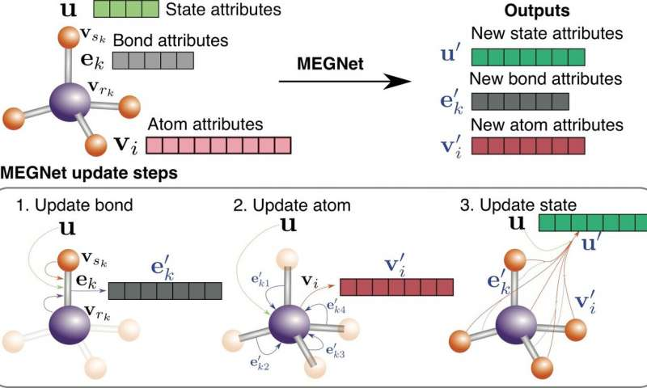
Node Attribute Prediction
Deep learning on cheminformatics graph networks to accurately predict properties of molecules and crystals
Chi Chen et al, Graph Networks as a Universal Machine Learning Framework for Molecules and Crystals, Chemistry of Materials (2019)

Slide 25
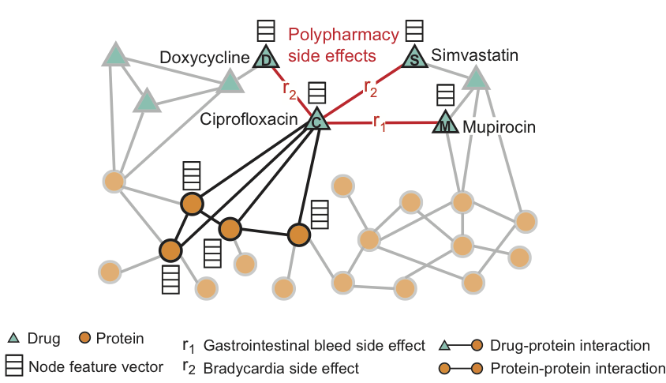
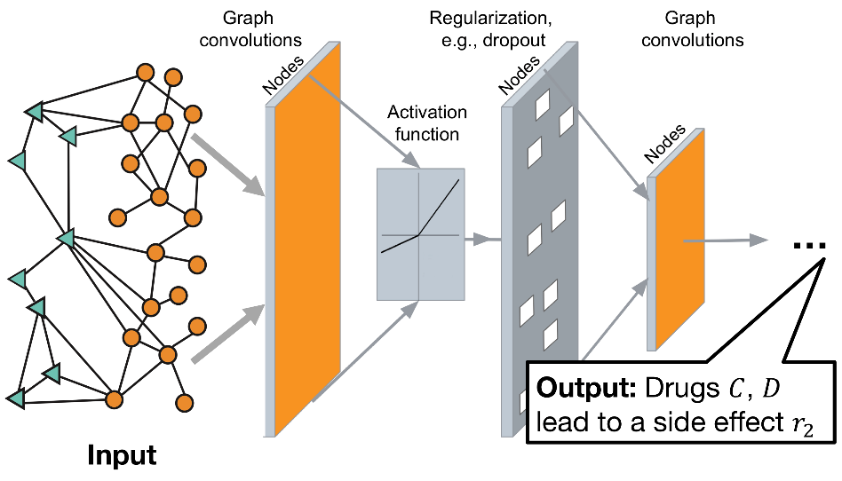
Drug Side Effect Prediction
Link Prediction
Graph Convolutional Networks can extract features embedded in a graph.
Modeling polypharmacy side effects with graph convolutional networks. Marinka Zitnik, Monica Agrawal and Jure Leskovec. Bioinformatics, 2018.

Slide 26
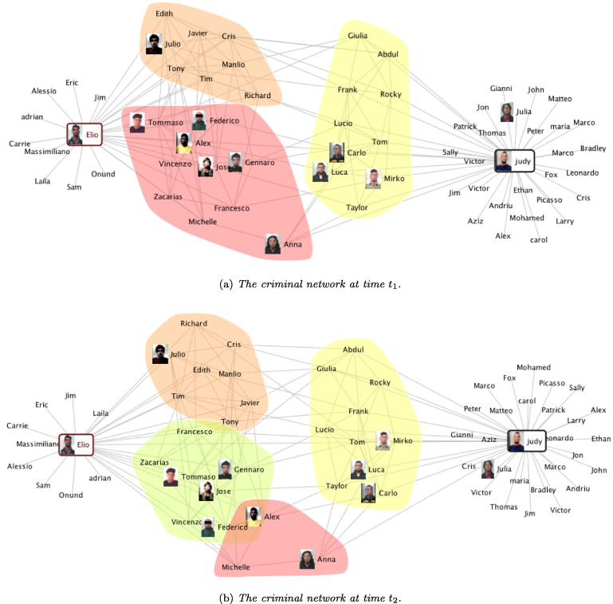
Detecting Criminal Organization in Social Networks
Detecting criminal organizations in mobile phone networks, Emilio Ferrara, Pasquale De Meo, Salvatore Catanese, Giacomo Fiumara, Expert Systems with Applications, 2014.

Slide 27
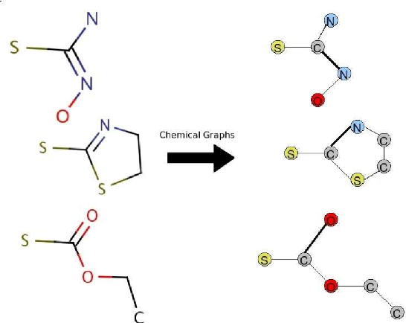
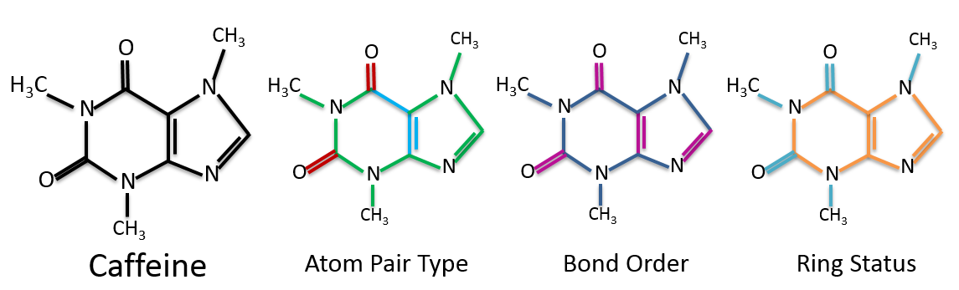
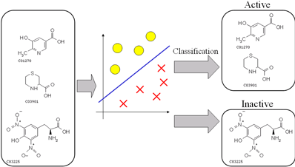
Graph Classification
Compound Activity Prediction

Slide 28
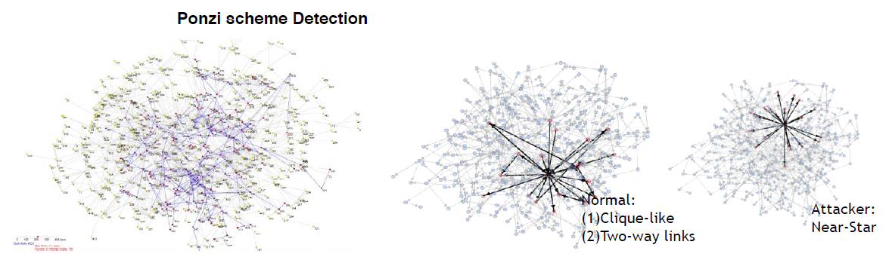
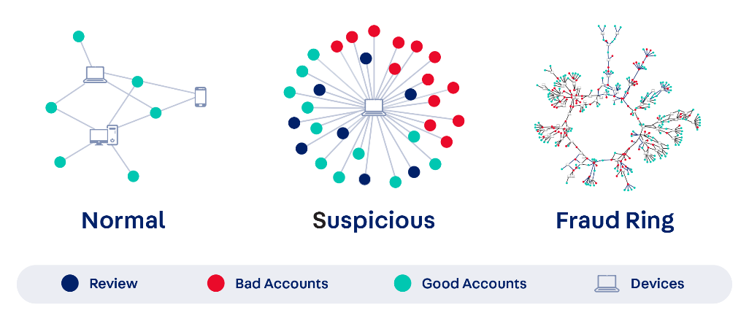
Pattern Identification
Identifying specific patterns in transaction networks can help detection fraud in banking

Slide 29
Agenda
The Growth of Data and Definition of Big Data
Handling Data with Large Volume
Handling Data of Different Types
Audio
Graph
Sensor
Text
Point Cloud
Handling Streaming Data
Pitfalls of AI and Data Analysis

Slide 30
Hydraspectral Sensor Data Analysis
Hyperspectral sensors are characterized by hundreds of narrow spectral bands, which enable identification of materials contained in pixels
Feature maps activated by convolutional filters can be used to precisely capture metal sheets (pink) and vegetative covers (green)
L. Mou, P. Ghamisi, and X. X. Zhu, “Fully conv-deconv network for unsupervised spectral-spatial feature extraction of hyperspectral imagery via residual learning,” in IEEE International Geoscience and Remote Sensing Symposium (IGARSS), 2017.

Slide 31
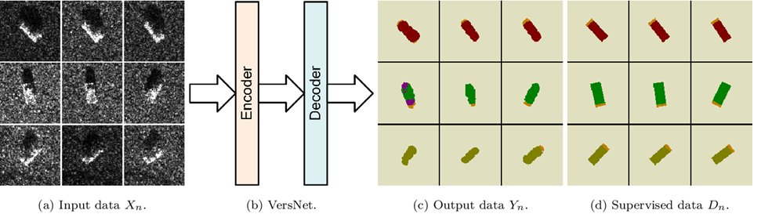
Interpretation of (Synthetic-Aperture Radar) SAR images
Automatic Target Recognition
Furukawa, H. (2018). Deep Learning for End-to-End Automatic Target Recognition from Synthetic Aperture Radar Imagery. ArXiv, abs/1801.08558.
Notes:
it is difficult for a human to recognize a target from SAR imagery since there is no color information and the shape reflected from a target changes.

Slide 32
Interpretation of (Synthetic-Aperture Radar) SAR images
Terrain Surface Classification in polarimetric SAR (polSAR)
Big data analysis on polSAR images automatically extract features that represent spatial patterns as well as polarimetric characteristics.
Z. Zhang, H. Wang, F. Xu, and Y. Q. Jin, “Complex-valued convolutional neural networks
and its applications to PolSAR image classification,” IEEE Transactions on Geoscience
and Remote Sensing, in press.

Slide 33
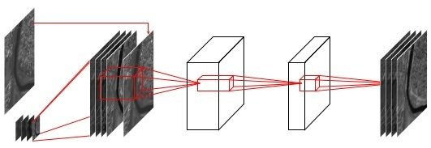
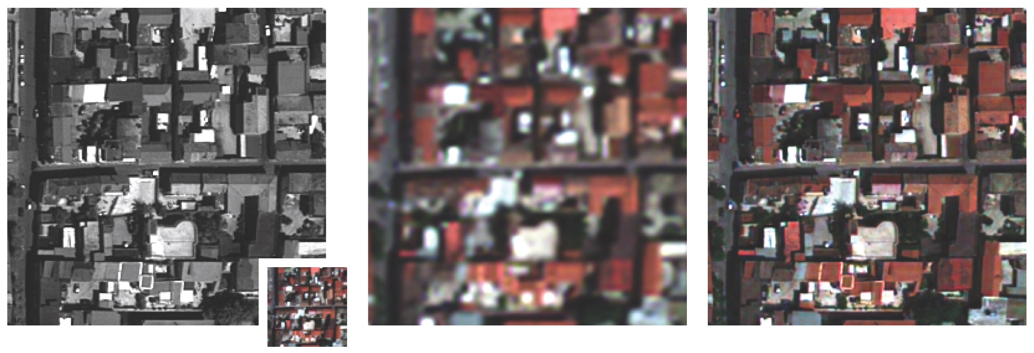
Multi-modal Data Fusion
Pansharpening
Using CNN to fuse multi-resolution GeoEye-1 sensor data for super-resolution results
Masi, G.; Cozzolino, D.; Verdoliva, L.; Scarpa, G. Pansharpening by Convolutional Neural Networks. Remote Sens. 2016, 8, 594.

Slide 34
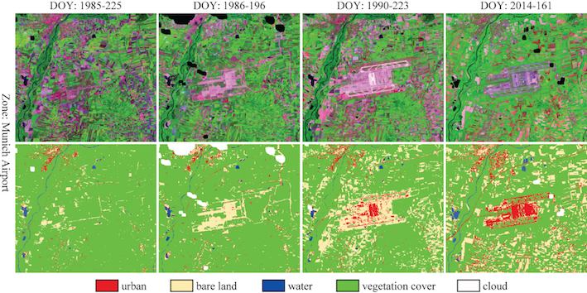
Multi-modal Data Fusion
Change Detection
Using large-scale and long-term multi-temporal image sequence, a deep learning-based system helps analyze how land cover changes. This example shows how Munich airport was built over the past 30 years.
H. Lyu, H. Lu, L. Mou, W. Li, X. Li, X. Li, J. Wang, X. X. Zhu, L. Yu, P. Gong,
“A deep information based transfer learning method to detect annual urban dynamics of four developed cities from 1984-2016 by Landsat data,” Remote Sensing of Environment

Slide 35
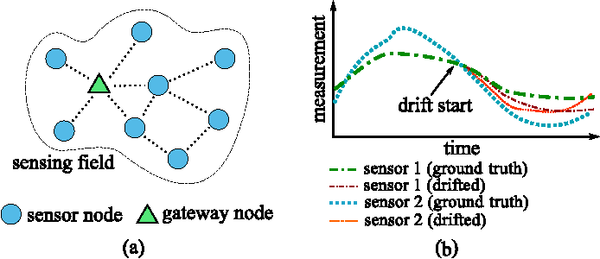
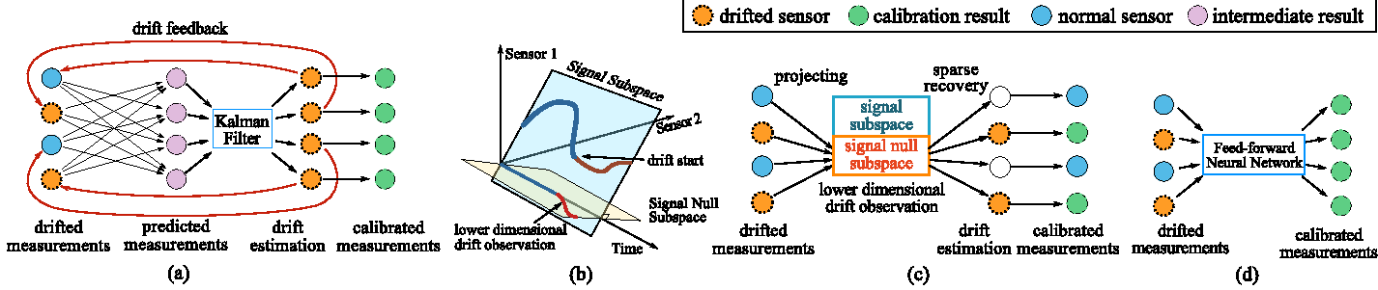
Blind Drift Calibration
The sensor drift problem
Calibrate deployed sensors without the ground truth based on data analysis.
Wang, Y., Yang, A., Chen, X., Wang, P., Wang, Y., & Yang, H. (2017). A Deep Learning Approach for Blind Drift Calibration of Sensor Networks. IEEE Sensors Journal, 17, 4158-4171.

